Slide 1
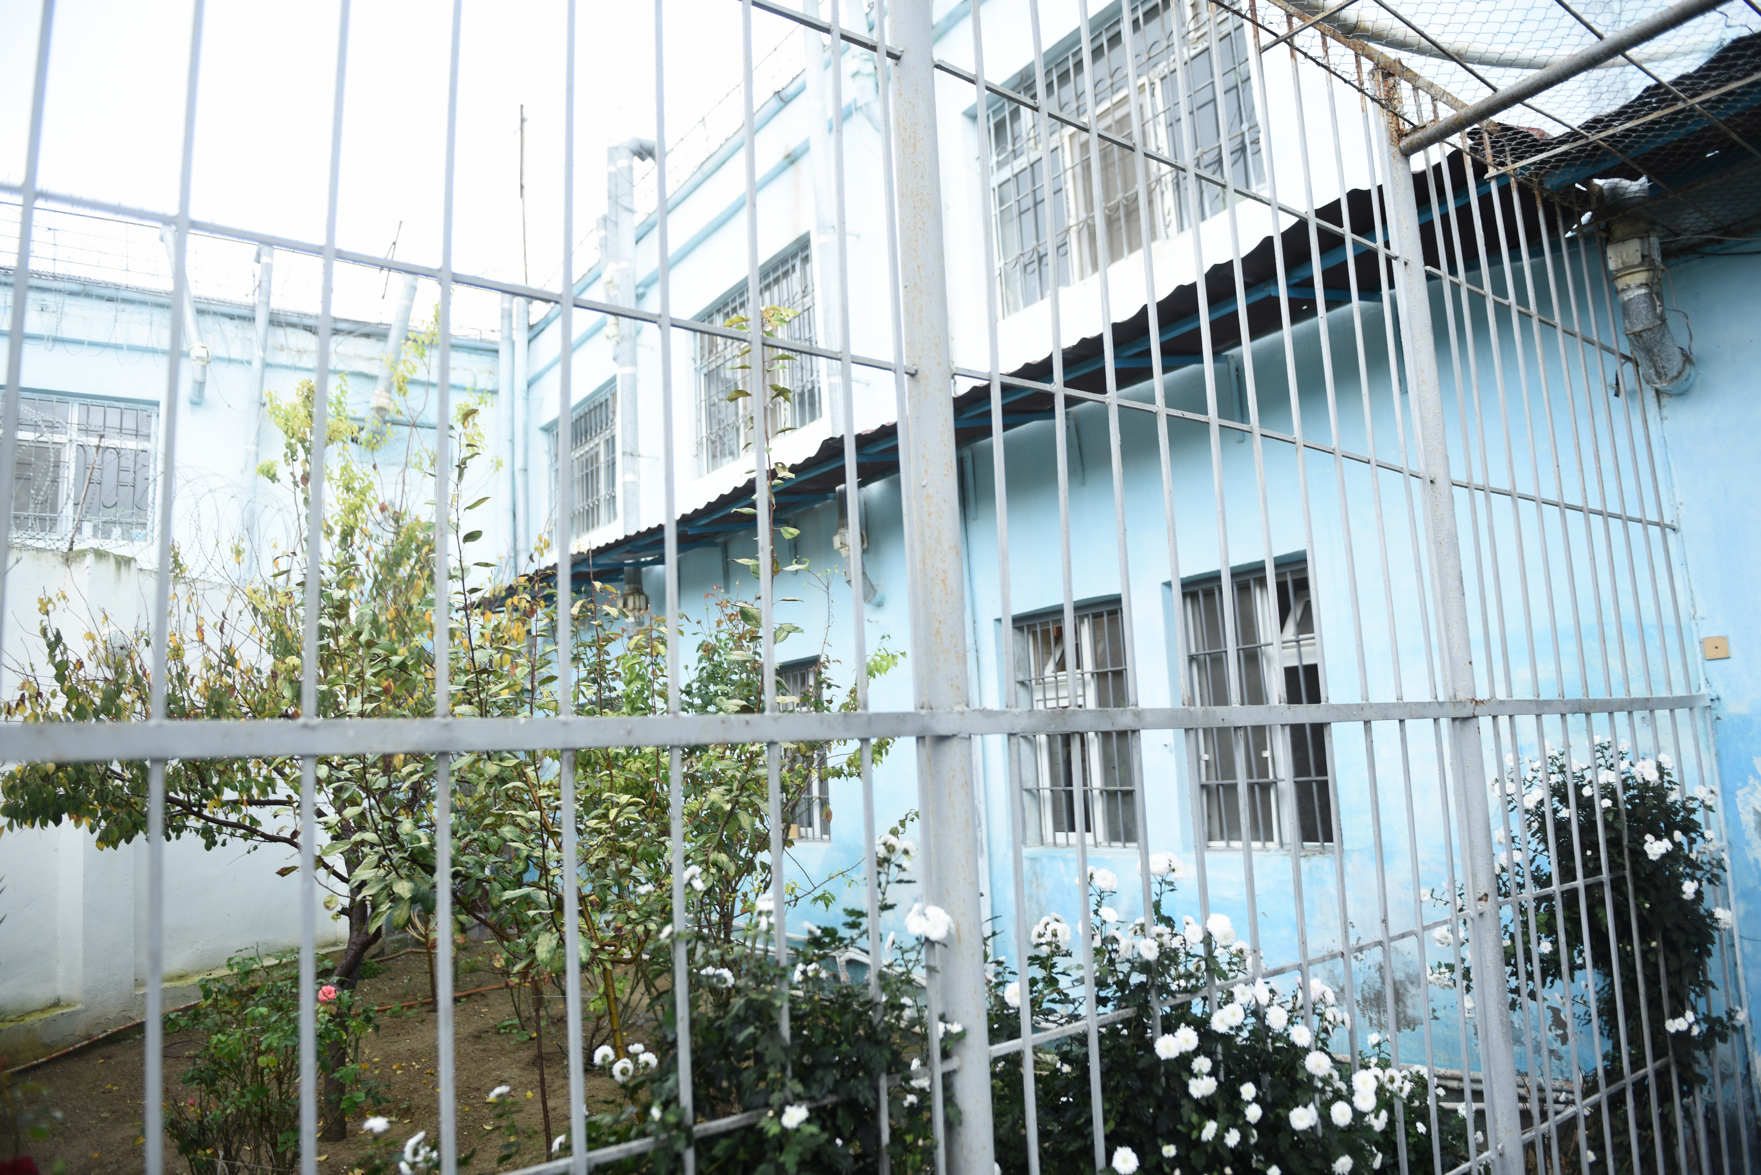
Implementing
TB control in prisons.
What is best practice and
what are the main challenges?
Natavan Alikhanova
MMD, WHO CC, MoJ Azerbaijan
Sunday, 22 July, 07:30-20:00
Room Elicium 1, RAI Amsterdam

Slide 2

More than 20 years of experience
History of establish and activities
2018
WGS with support from SRL
New and repurposed medicines - GF
SLD – MMD budget
WHO CC on prevention and control of TB in prisons
FLD – MMD budget
Training Center, etb-manager
LPA (HAIN), NGO “Follow-up after release” Project
Piloting of Xpert MTB/RIF machine
FLD – GF budget
Human resources capacity and protection, Baktec, SLD DST Certificate from SRL
FLD – KfW, Germany budget
Microscopy lab at STI, Epi Info6
Establish of the Specialized Treatment Institution for TB patients, 900 beds
Starting implementation DOTS in prisons with support of ICRC, FLD – ICRC budget
2017
2016
2014
2013
2012
2010
2009
2007
2006
2005
1998
1995

Slide 3
Main steps toward success
Patient-oriented approach
Entry screening
Annual screening
Passive investigation
Rapid diagnostic tests (Xpert MTB/RIF, LPA 1st and 2nd line DST)
Rapid separation of presumptive and confirmed TB patients, based on bacteriological status (+/-) and DST
Individualized treatment schemes
HIV testing and counselling
IPT among HIV+, ART
Follow-up after release, NGO “Support to Health”

Slide 4
TB notification, AZ prisons, 2005-2017, per 100 000
TB notification in the prisons 20 time higher than in civil sector of AZ
Incidence, civil sector

Slide 5
TB mortality, AZ prisons, 1995-2017, per 100 000
5236
In 2017 the death rate for all diseases decreased 16 times, and the death rate from TB decreased 105 times in comparison with 1995.
1014
459
142
54
49

Slide 6
Treatment outcomes with FLD, % AZ prisons, 1995-2016
85%
Treatment success - 91% for last
DS TB patients cohort

Slide 7
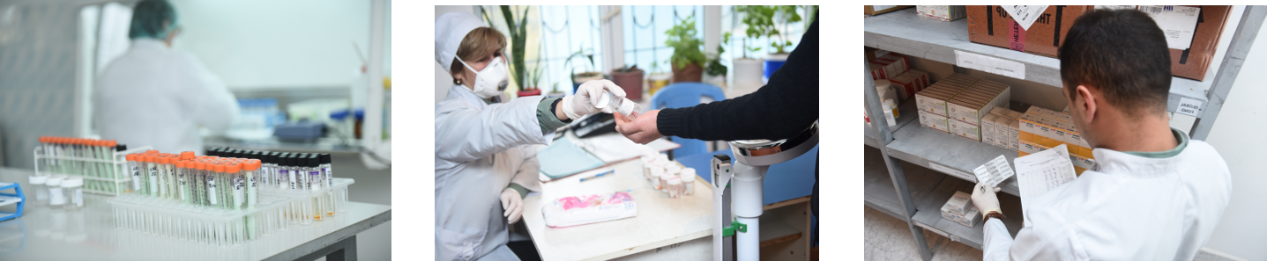
Treatment outcomes with SLD, % AZ prisons, 2007-2015
93%
H-mono-,
polyresistance
75%
77%
RR TB
33%
XDR TB
Notes:
To boost access to modern algorithms of diagnostics and treatment
To improve quality of the services through patient-centered approach
To support human resources
To involve civil society in TB control
To strengthen surveillance system and local evidence base

Slide 8
TB/HIV
99.9%
HIV testing among TB patients
Behavioural
Biomedical
Interventions
93%
ART coverage among TB/HIV
Year of IPT | 1st year after IPT | 2nd year after IPT | 3rd year after IPT | 4th year after IPT
2013 | 3,7% | 5,6% | 2,9% | 3%
2014 | 3,7% | 5,6% | 2,9%
2015 | 3,6% | 4,2%
2016 | 4,1%
Notes:
Behavioural – sex education, counselling, program to reduce stigma and discrimination
Biomedical – condoms, testing, treatment, needle exchange, PMTCT, OST
Structural – intervention to address inequality, decriminalization, increasing access to schooll education, lows protecting the rights of people living with HIV

Slide 9
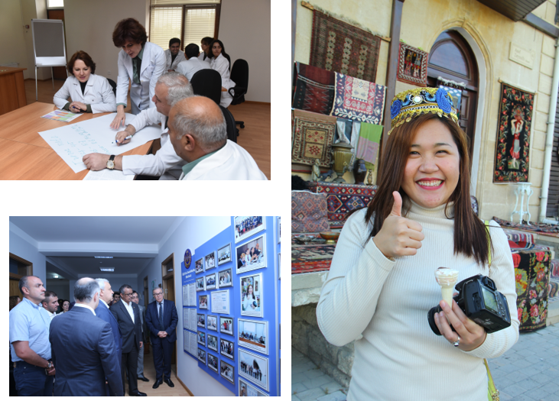
WHO CC - Sharing experience
8 International Training Courses –
96 trainees, from 17 countries
Workshops and study tours –
120 participants from 11 countries

Slide 10
Main challenges
NSP, OST
HCV treatment
Latent TB infection
WGS (epidemiological surveillance), OR
Sustainability after 2020-2021

Slide 11
We need to boost full-scare efforts to improve the health of detainees and prisoners
Thank you for attention!
Notes:
We need to fully enhance the work to improve the health of detainees and prisoners
We need to boost full scare efforts to improve the health of detainees and prisoners

